Slide 1
IoT Monitoring Dashboard Capstone Project — Milestone Progress Update
Program : BAS Application Development
Course : CSI-492 Senior Capstone Project
Student : Quoc Bao Tran Date : 4/19

Slide 2
Schedule Update Status: On track
Project Progress Update
Time Period | Dates |  | Focus |  | Status/Progress Update
Week 1–2 | 4/6 – 4/19 |  | Planning — project charter, requirements, architecture |  | Project charter approved; requirements documented; architecture defined (MQTT → API → SQL → SignalR → React).
Week 3–4 | 4/20 – 5/3 |  | Data — SQL Server schema, EF Core entities, migrations, seed/test data
Week 5–6 | 5/4 – 5/17 |  | Backend — repositories, services, REST API, MQTT ingest, command dispatch, SignalR, alerts.
Week 7–8 | 5/18 – 5/31 |  | Frontend — React dashboard, auth, live charts, devices, commands, alerts UI
Week 9–10 | 6/1 – 6/14 |  | Integration & testing — Arduino ↔ Mosquitto ↔ API ↔ SQL ↔ SignalR ↔ UI (end-to-end)
Week 11 | 6/15 – 6/19 |  | Documentation & presentation — final docs, polish, demo prep → Final presentation 6/17

Slide 3
Milestone Summary
Status: Completed
Goal: Define project scope, requirements, and architecture before build (database, backend, frontend).
Completed work:
Project charter & scope (001_Overview.md)
Functional requirements — devices, sensors, readings, alerts, commands, roles (002_Requirements.md)
Tech stack: ASP.NET Core 8, React + TypeScript, SQL Server, EF Core, MQTT, SignalR, JWT
Layered architecture & data pipeline (004_ApplicationDesign.md)
MQTT topics: devices/{id}/sensors/{id}/readings, devices/{id}/commands
Development schedule: plan → data → backend → frontend → test → present
Progress: Charter approved; requirements documented; architecture defined (MQTT → API → SQL → SignalR → React).

Slide 4
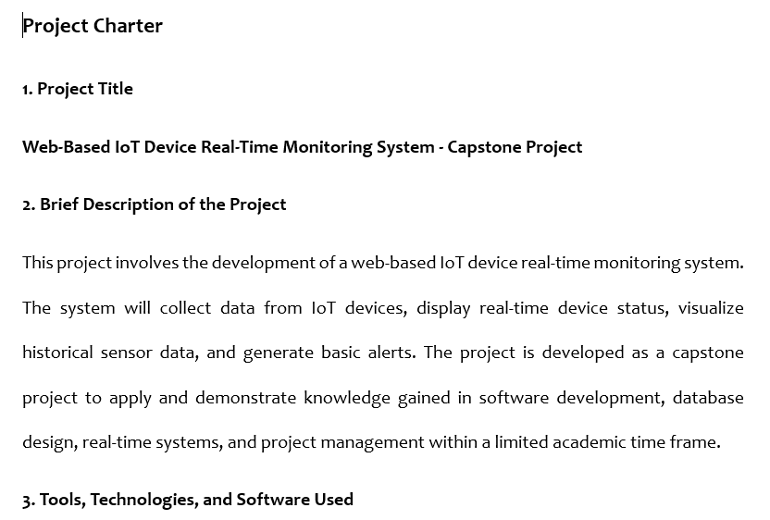
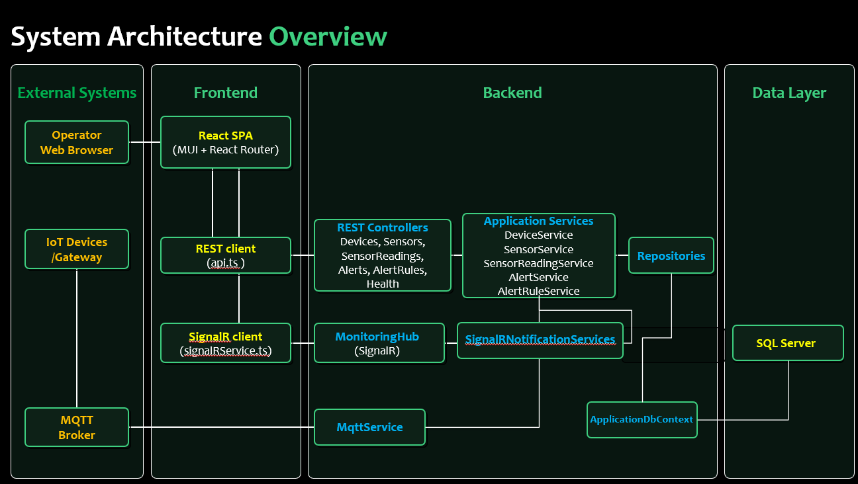
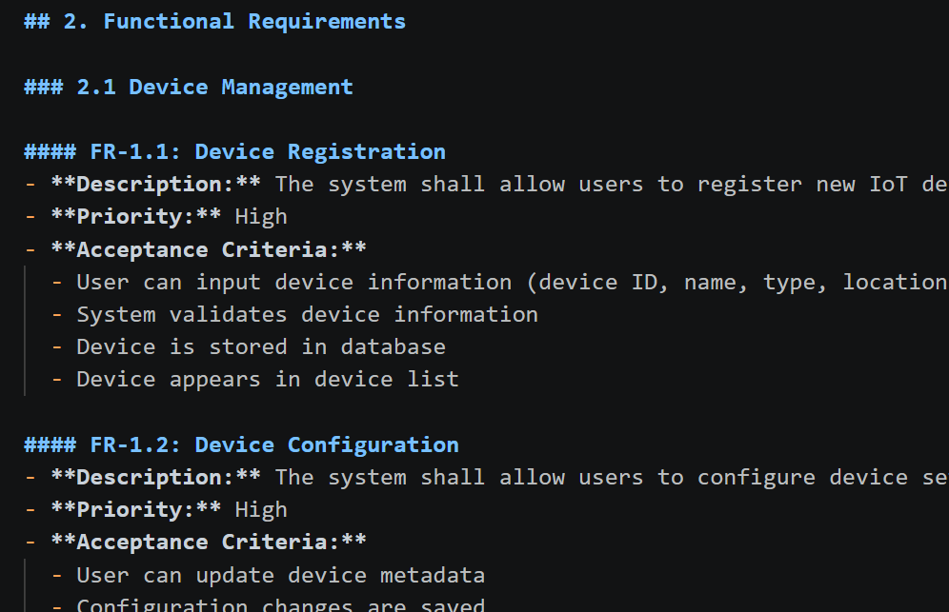
Evidences/ Screenshots
Fig. 1 — Charter / scope
Fig. 2 — Architecture
Fig. 3 — Requirements

Slide 5
Problems & solutions
Problem | Solution
Scope too large for capstone timeline | Prioritized core path: one device type, temperature/humidity, alerts, commands; deferred advanced features
Unclear MQTT vs HTTP for edge ingest | Chose MQTT for Arduino; REST for UI and management
Role model not defined early | Defined Admin, Operator, Viewer in requirements before UI build
Stack choices needed alignment with coursework | Standardized on C# API + React + SQL Server per program skills

Slide 6
Barriers
No other critical blockers at this milestone.

Slide 7
Reflection & next steps
Learned: Clear requirements and architecture reduce rework; defining MQTT topics and roles early prevents integration issues later.
Next (Week 3–4): SQL Server schema, EF Core entities, migrations, and seed/test data.

